Slide 1
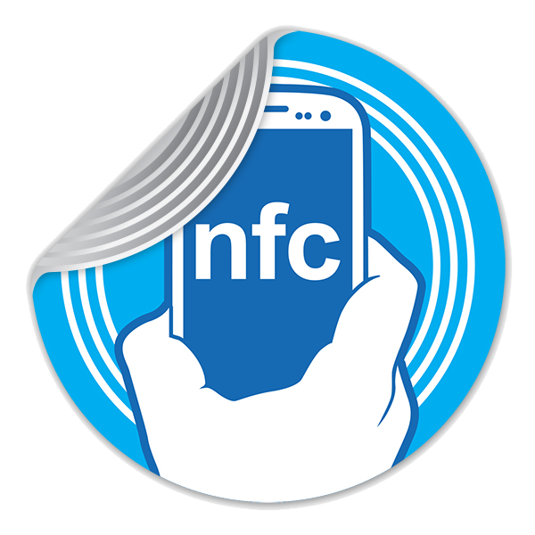
What is NFC?
Near Field Communication
Builds upon RFID
Is the starting point for other communication technologies
Android Beam
Bluetooth Pairing
S-Beam

Slide 2
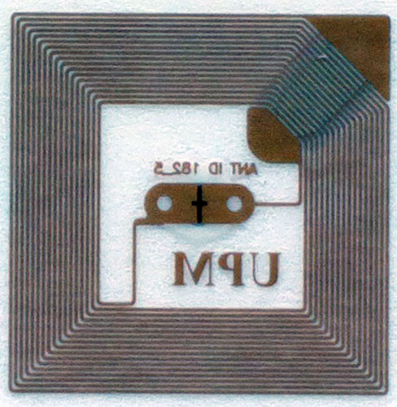

Slide 3
Name | Available memory | URL length | Text length | NFC Class | Windows Phone 8 support
Ultralight (UL) | 48 bytes | 41 characters | 39 characters | Type 2 | yes ^{(?)}
Ultralight C (ULC) | 148 bytes | 132 characters | 130 characters | Type 2 | yes ^{(?)}
NTAG203 | 144 bytes | 132 characters | 130 characters | Type 2 | yes ^{(?)}
MiFare 1K | 1024 bytes | 256 characters | 709 characters | Classic (1) | yes
Fudan F08 | 1024 bytes |  |  |  | ?
DESFire EV1 2k | 2048 bytes |  |  | Type 4 | yes ^{(?)}
DESFire EV1 4k | 4096 bytes |  |  | Type 4 | yes ^{(?)}
DESFire EV1 8k | 8192 bytes |  |  | Type 4 | yes ^{(?)}
Sony FeliCa 4K | 4096 bytes |  |  | Type 3 | yes ^{(?)}
Sony FeliCa Lite | 224 bytes |  |  | Type 3 | yes ^{(?)}
Topaz | 512 bytes |  |  | Type 1 | yes
Notes:
NFC tags use RFID passive chipset. This chipset can be produced with different technology and available memory. To help you to choose a NFC tag type, this table overview NFC Tags type with their principal characteristics.

Slide 4



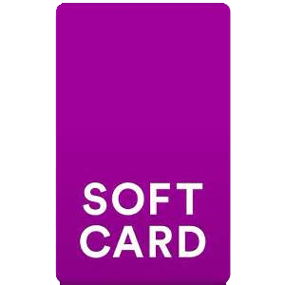
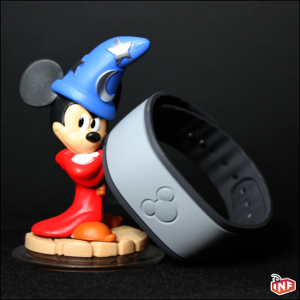
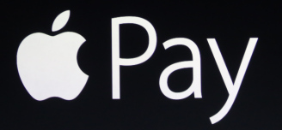
So where is the Magic?

Slide 5
NFC Payment
Notes:
Google Wallet – Secure Element
Windows Phone – Requires Secure SIM Card
Apple Pay – Requires iPhone 6 or better

Slide 6
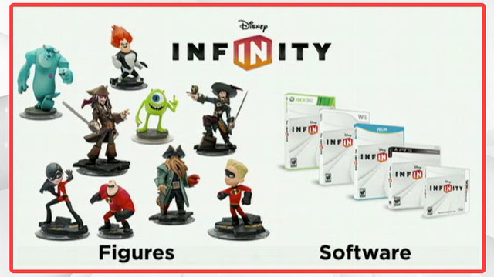
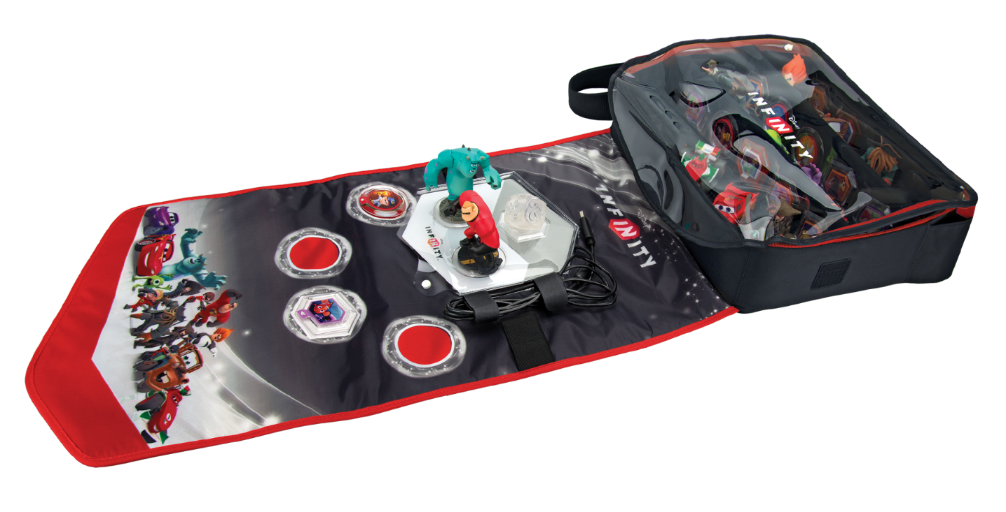

Slide 7

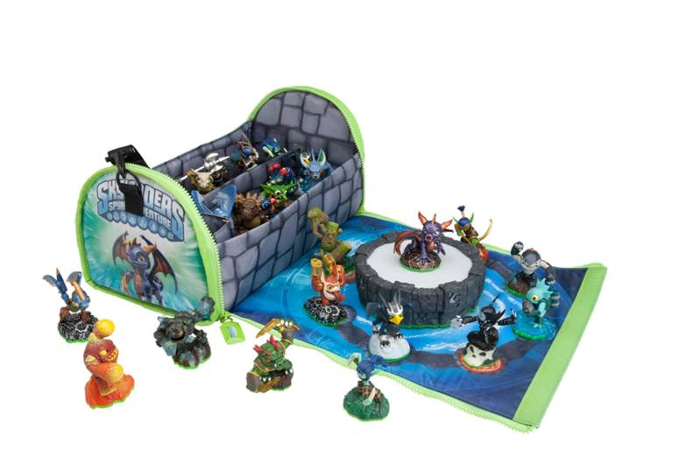

Slide 8
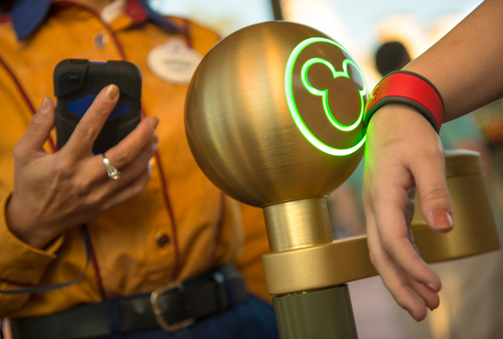
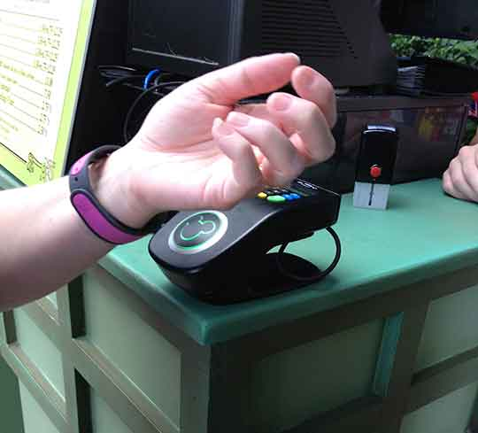
Disney Magic Band

Slide 9
Demo

Slide 10


Sean Sparkman
Team Lead
Senior Developer
President
@DFWMobileNET
Email: sean.sparkman@gmail.com Twitter: @seansparkman

